Slide 1
Web App Story Board
Go into presentation mode for button links to work.

Slide 2

Incident Management System
Back
Home
Create
Tickets
Search
Help
Landing info for user…
Scroll
Create an Incident Ticket
View Ticket List
Search Ticket List
Gary
Index.php
Notes:
Home page. Has links to the major functions.

Slide 3
Incident Management System
Back
Home
Tickets
Search
Create
Help
Enter Keyword(s)
Select Search Fields
Blah blah blah
All Fields
Search
Done
Search.php
Notes:
Search page. Enter keywords and select search field. Search takes to incident ticket summary page.

Slide 4
Incident Management System
Back
Home
Tickets
Search
Create
Help
View All Tickets
View Open Tickets
View Resolved Tickets
View Closed Tickets
View On-Hold Tickets
All not working
TicketMenu.php
Notes:
Ticket list selection page. Has prebuilt options to filter list based on ticket status

Slide 5


Incident Management System
Back
Home
Tickets
Search
Create
Help
Title
similar
Icon
Date
Description
Title
similar
Icon
Date
Description
Title
Icon
Date
similar
Description
Done except for linking to update page
TicketSummary.php
Notes:
list of incident summaries. Can click on a summary to view full ticket, edit, delete, or view similar tickets.

Slide 6
Incident Management System
Back
Home
Tickets
Search
Create
Help
Ticket Id
123
Ticket Status
Open
Contact Type
Phone
Customer Contact info
867-5309
Date Created
11/10/2022
…
Done
TicketView.php
Notes:
View All fields. Fields are view only

Slide 7
Incident Management System
Back
Home
Tickets
Search
Create
Help
Ticket Id
123
Ticket Status
Open
Contact Type
Phone
Customer Contact info
867-5309
Date Created
11/10/2022
…
Update
TicketUpdate.php
Notes:
Update fields. Fields are interactable. Has an update button with “are you sure” popup

Slide 8
Incident Management System
Back
Home
Tickets
Search
Create
Help
Ticket Created Successfully
Contact Type
Phone
Customer Contact info
867-5309
Date Created
11/10/2022
…
Create
Chuan
TicketCreate.php
Notes:
Create ticket page. Fields will be blank. Certain fields will be required.

Slide 9
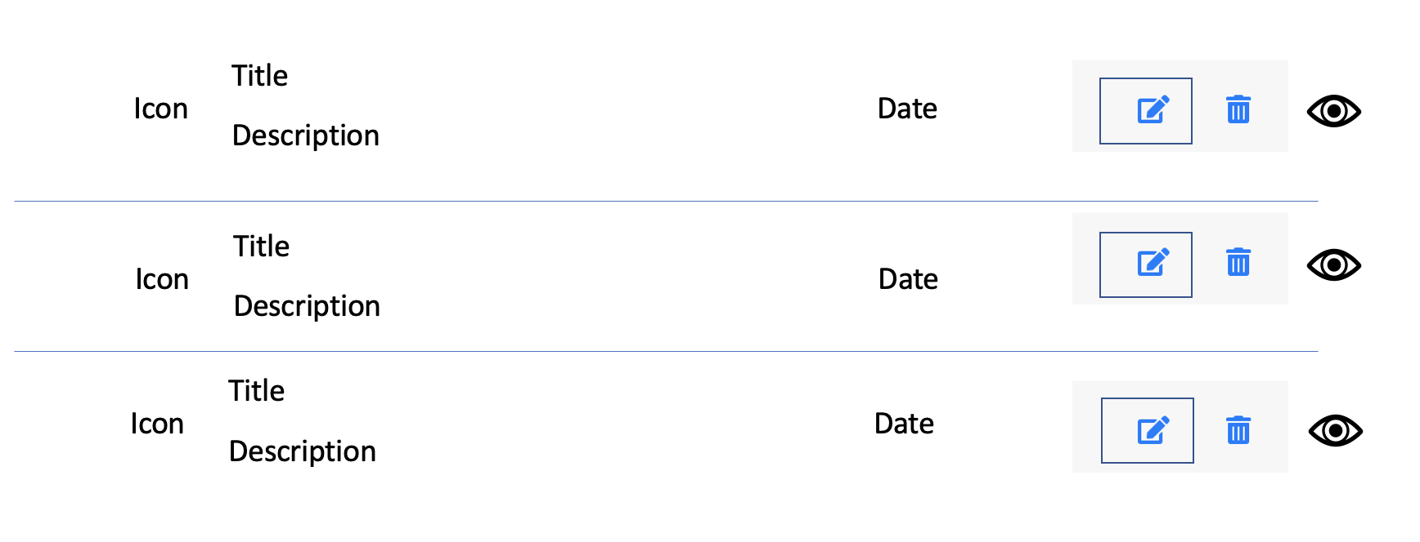
Incident Management System
Back
Home
Tickets
Search
Create
Help
Ticket Created Successfully!
Similar Tickets:
TicketConfirmed.php
Notes:
Skip this page for now.
Successful ticket creation splash page. Will automatically pull any similar tickets.

